Slide 1
Connecting learning and real-world
Notes:
The acronym for science, technology, engineering, arts, and math recognizes the need to integrate content standards and student performance objectives as they connect to real world applications.
ART: social, fine, manual, physical, and liberal arts actually expand on and influence the traditional STEM fields of study. For example,
Language arts is a means to share ideas, life experiences, and perspectives
Manual and physical arts influence such areas as ergonomics
Fine and musical arts reflect society’s values and directions in the past and present
Social and liberal arts are a context for studying attitudes, ethics, and customs
Examples: Architecture, product packaging, kite design
Can you think of more?
The goal of STEAM is to teach students how to better learn and apply new knowledge from a multidisciplinary, reality-based perspective.

Slide 2
What is engineering?
Intro to engineering
Notes:
NASA video providing students with an explanation of what it is that engineers do.

Slide 3
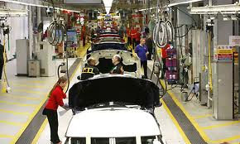
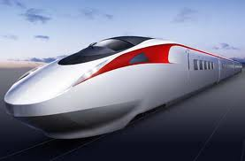
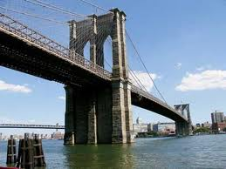
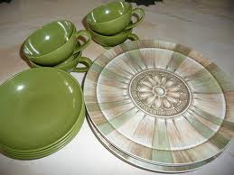
What is Technology?
√
X
Notes:
What is technology?
Place students in pairs or small groups (3-4 students) and allow them to complete one of the following tasks:
a. As a group, discuss ideas for what would place something in the “technology” or “not technology” group. Then come up with 3 more examples for each of the groups and explain why your group feels they belong
b. As a group, create a definition for “technology” using the information given to support your definition
Technology is anything created by humans to make life easier and/or to solve a problem or provide a solution to a need.

Slide 4
Technology can solve a problem or make life easier Technology can be an object, a system, or a process
Notes:
A system is a group of parts working together to accomplish a task. (machine, catapult, manual pencil sharpener)
A process is a series of steps used to accomplish a task (pasteurization and/or sterilization of food, harvesting crops)

Slide 5
Engineer
Someone who uses math, science, and creativity to design new technologies or improve existing technologies
Technician
Someone who installs and/or fixes technology
Artisan
Someone who builds and/or creates things using technology
Notes:
Use this slide to build a student activity:
Preparation: Print on cardstock and cut the vocabulary words from the definitions. Allow student teams to match definitions with vocabulary. Challenge teams to identify as many examples of careers/work for each term.
Have a conversation about the similarities and differences of these roles.

Slide 6
Explore engineering!
eGFI – Dream Up the Future
DESIGN SQUAD NATION . Home | PBS KIDS GO!
Notes:
Interactive websites for students to explore the work of engineers.
Teacher resources include lesson plans for STEM/STEAM and engineering design challenges

